Slide 1
Terrestrial Biomes
Providing habitat since the Earth was formed.

Slide 2
Objective
At the end of this unit, SWBAT –
Identify, describe, and locate major biomes of the world.
Identify the abiotic factors that influence biome distribution in order to describe plants and animals that are characteristic to specific areas.

Slide 3
Terrestrial Biomes
Tropical Desert
Temperate Desert
Tundra (Polar Grassland)
Coniferous Forest (Taiga/Boreal Forest)
Tropical Grassland (Savanna)
Temperate Deciduous Forest
Temperate Grassland
Temperate Rainforest
Tropical Rainforest
Tropical Deciduous Forest
Chapparal
Snow and Ice Caps

Slide 4
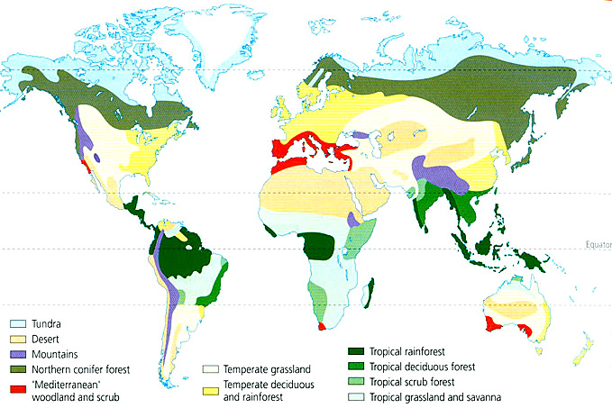
Locations

Slide 5
Arctic Tundra
Located in northern hemisphere only (no land mass at that latitude in southern hemisphere), near Arctic Circle.
Long cold winters, little precipitation.
Wildlife mainly small mammals.
Vegetation short shrubs and grasses. Due to both short growing season and permafrost.
Major threat is Climate Change, and secondary would be Fossil Fuel Extraction.

Slide 6
Taiga
Located just south of Arctic Tundra, in northern Canada and northern Siberia.
Weather not as extreme. Longer summers, winters not as extreme.
Precipitation more than Tundra. Can support more vegetation. Vegetation primarily coniferous trees. Needles are adaptation.
Wildlife are larger mammals, migratory herds.
Major threat is deforestation (logging).

Slide 7
Temperate Rain Forest
Located in Pacific Northwest (N. California – Canada).
Mild winters, cool summers. Abundant rainfall (due to “Rain Shadow Effect”).
Wildlife are primarily birds and small mammals (squirrels), due to shaded “understory”.
Vegetation are large Coastal Redwoods/Sequoias.
Threat is deforestation (logging).

Slide 8
Temperate Deciduous Forest
Eastern United States (Mid-Atlantic).
Temperate climate (all 4 seasons).
Influenced by proximity to warm water (Gulf Stream) results in high humidity.
Wildlife include a wide variety of organisms. Mammals, reptiles, amphibians and birds are present.
Major threat has been deforestation. Recently, exurbanization (suburban sprawl) continues the destruction of this habitat.

Slide 9
Tropical Grasslands
Located near the Equator, sometimes referred to as Savanna.
Moderately hot year round with a pronounced rainy season alternating with seasonal drought.
Wildlife include huge herds of migrating hoofed mammals, birds, reptiles and amphibians.
Grasses have extensive root systems which allow plants to survive drought and fire.
Major threat is overgrazing.

Slide 10
Temperate Grasslands
Located in the Great Plains and midwest US.
4 distinct seasons. Temperatures range from below freezing to nearly 90 degrees, with moderate rainfall primarily in late Spring/Summer.
Wildlife includes a wide variety of insects, mammals, and birds.
Like the Tropical grasslands, the plants here possess extensive root systems to survive drought and fire.
Threats include overgrazing and monoculture.

Slide 11
Chaparral
Typically found on the Mediterranean coast, chaparral is also found in the mountins of the Los Angeles basin, in California.
Mild winters and long, hot, dry summers.
Wildlife includes small mammals and birds.
Vegetation is typically small evergreen bushes, with fire resistant leaves and bark.
Threats are development and fire control measures, which allow fuel (dead wood) to accumulate.

Slide 12
Tropical Rain Forest
Found near the Equator.
Ample rain year-round (between 8 – 15 feet).
Warm to hot temperatures.
Wildlife are numerous, mainly insects, birds, and smaller mammals/reptiles/amphibians.
Soil tends to be very thin, devoid of nutrients. Dead plant material decomposes rapidly and is quickly absorbed by other plants.
Vegetation tends to be broadleaf evergreens.
Major threat is deforestation.

Slide 13
Tropical Desert
Typically located in the interior of continents, downwind of a mountain range, along the Equator.
High temps and scant rainfall (less than 1” per year).
Wildlife includes small, nocturnal animals with adaptations for surviving with little water. Almost no animals have fur.
Vegetation includes succulents like cacti.
Threats are off-road vehicles, development, and oil extraction.

