Slide 1
Renewable Energy
It’s renewable ‘cuz you can use it over and over, and it is (seemingly) limitless.

Slide 2
Objective
SWBAT evaluate the various types of Renewable Energy, identify problems with their use, and propose meaningful solutions to any problems identified.

Slide 3
Two Types of Renewable Energy
Since Renewable energy is supplied by the Sun, we often refer to it as “Solar Energy”.
Two types – Direct and Indirect.
Direct Solar Energy is energy in the form of light that is streaming from the Sun to a collection device.
Indirect Solar Energy is energy from the Sun that passes through at least one intermediate step, or conversion, before being gathered by a collection device.

Slide 4
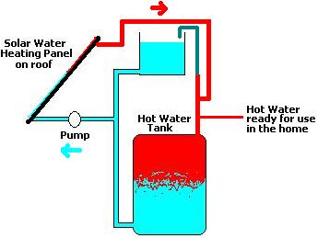
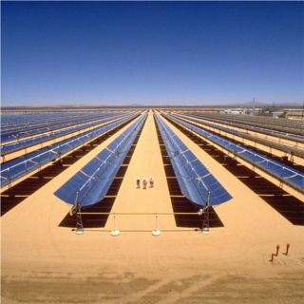
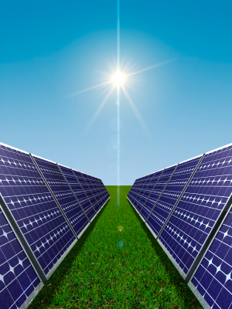
Direct Solar Energy
Two types of Direct Solar Energy – Active and Passive.
Direct Active utilizes some form of energy to assist in the gathering or conversion of light energy into another form of useful energy.
Examples include Solar Heat panels, Photovoltaic (PV) Cells, and Solar Arrays.

Slide 5
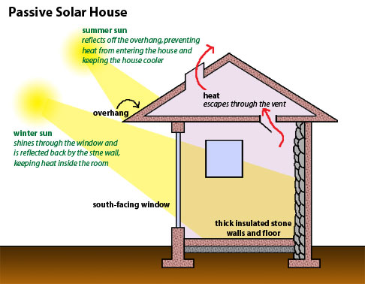
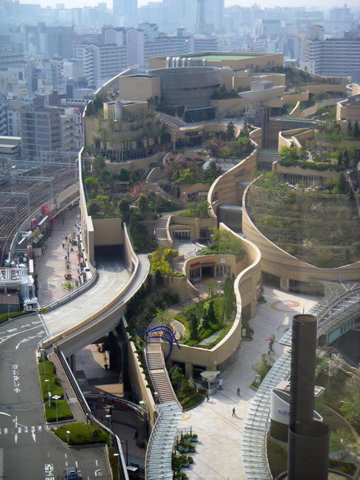
Direct Passive Solar Energy
Relies on design, materials, and construction to take advantage of available solar energy.
Examples include passive solar “envelope” homes and “green” architecture.

Slide 6
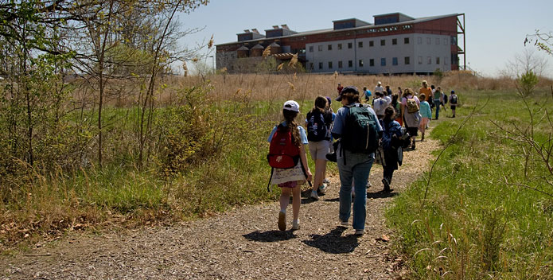
Chesapeake Bay Foundation – Merrill Center
Built in 2000 in Bay Ridge, MD (outside of Annapolis) on banks of Chesapeake Bay.
1st commercial building LEED Platinum certified.
Takes advantage of design, site orientation, and sun declination to minimize cooling and heating costs as well as electricity and water usage.
http://www.cbf.org/about-cbf/offices-operations/philip-merrill-environmental-center/what-makes-us-green

Slide 7
Indirect Solar Energy
Hydroelectricity
Wind Energy
Biomass
Geothermal
Solar Hydrogen

Slide 8
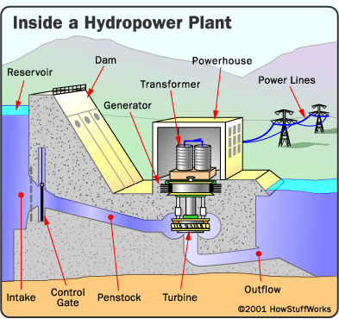
Hydroelectricity
Utilizes the kinetic energy of moving water to generate electricity.

Slide 9
More Hydroelectricity
Tidal and Wave power.
Uses kinetic energy of seawater to generate electricity.

Slide 10
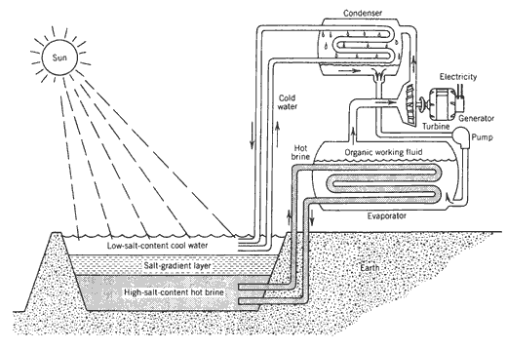
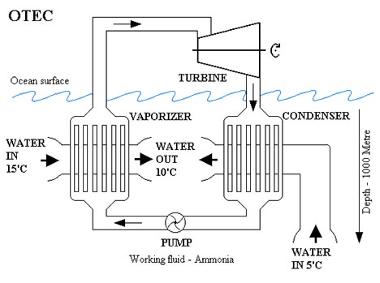
Still more Hydroelectricity
Thermal ponds and Ocean thermal energy.

Slide 11
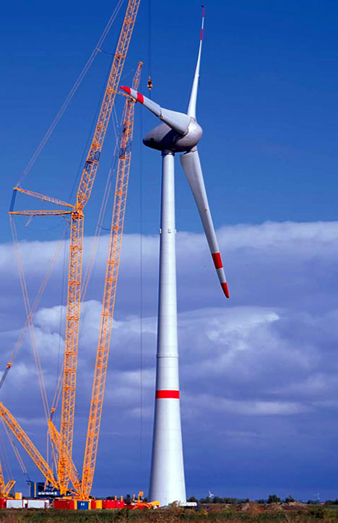
Wind Energy
Kinetic energy of moving air is converted to electricity.

Slide 12
Biofuel (Biomass)
Organic material used for fuel.
Can be used as solid, liquid, or gas.
Wood, grass, and dung.
Less concentrated energy than fossil fuels.

Slide 13
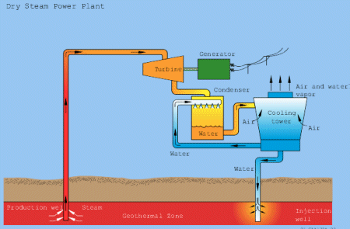
Geothermal
Utilizing heat energy in the Earth’s crust to heat and generate electricity.

Slide 14
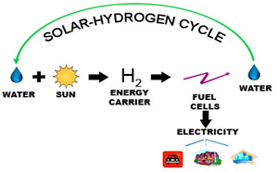
Solar Hydrogen
Water is split into O and H₂.
H₂ is burned or reacted in the presence of oxygen.
Waste product is water vapor.
The trouble lies in splitting the water.

