Slide 1
Ozone Depletion and Climate Change
Both involve the atmosphere, but they are not the same thing.

Slide 2
Ozone
O₃
Ozone has been present in the atmosphere since cells began photosynthesizing (~3.4 BYA).
Formed when UV radiation ionizes molecular oxygen (O₂) and then recombines to form O₃.
Ozone has gathered in the upper stratosphere and, by using UV rays to form new molecules, protects us from the harmful rays.
Thinning of the ozone layer has been noted for decades.

Slide 3
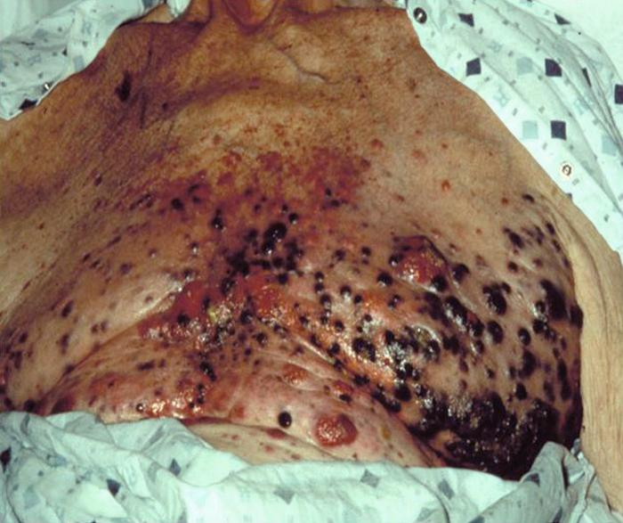
What’s the big deal?
Cataracts – clouding of the lens of the eye. Can be treated by lens replacement.
Skin Cancer – primarily melanoma. Melanoma is a rare form of skin cancer, but is extremely deadly.

Slide 4
The Chemistry of Ozone.
Three forms of oxygen are involved in the ozone-oxygen cycle: oxygen atoms (O, or atomic oxygen), oxygen gas (O_{2,} or diatomic oxygen), and ozone gas (O_{3,} or triatomic oxygen).
Ozone is formed in the stratosphere when diatomic oxygen molecules photo-dissociate after absorbing an ultraviolet photon.
This converts a single O₂ into two atomic oxygen ions.
The atomic oxygen ions then combine with separate O₂ molecules to create two O₃ molecules.
These ozone molecules absorb UV light following which ozone splits into a molecule of O₂ and an oxygen atom.
The oxygen atom then joins up with an oxygen molecule to regenerate ozone.
This is a continuing process which terminates when an oxygen atom "recombines" with an ozone molecule to make two O₂ molecules.

Slide 5
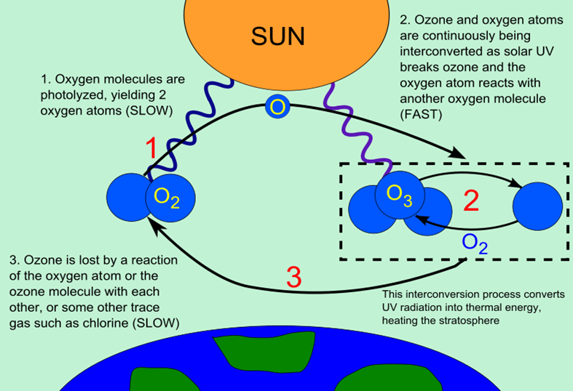

Slide 6
What’s causing the problem?
In a word “balance”.
In searching for chemicals that could be used as refrigerants, a Belgian scientist developed a molecule known as Chlorofluorocarbon (CFC).
In addition to being an excellent refrigerant, CFCs have been found to be effective propellants.
These propellants can be used in aerosol cans to deliver products, clean electronic circuitry, and create foam from polymer paste.
Unfortunately, these same molecules have a nasty habit of destroying ozone molecules.
One CFC molecule has the potential to degrade up to 100,000 ozone molecules before being denatured.

Slide 7
Attempts to control and regulate CFC use.
By the mid-1970s, the damage to the ozone layer as a result of CFC use had been documented and researched.
Many countries began to individually ban the use of these chemicals.
In 1977, the United States voluntarily banned the use of CFCs by all entities except the military.
In 1987, the Montreal Protocol was ratified, and has been revised seven times. The total number of signatories stands at 196 countries/states.
By 2050, the ozone layer is likely to have fully recovered.

Slide 8
Climate Change
Was originally labeled Anthropogenic Global Warming. (“Anthropo” = human, “-genic” – produced by)
While this label is technically correct, it is widely misunderstood as meaning it will get warmer everywhere.
As a result, many have focused on the “warming” and refuse to consider the climate change.
Global Warming addresses the climb in mean global temperatures.
The only question is – What/who is causing this?

Slide 9
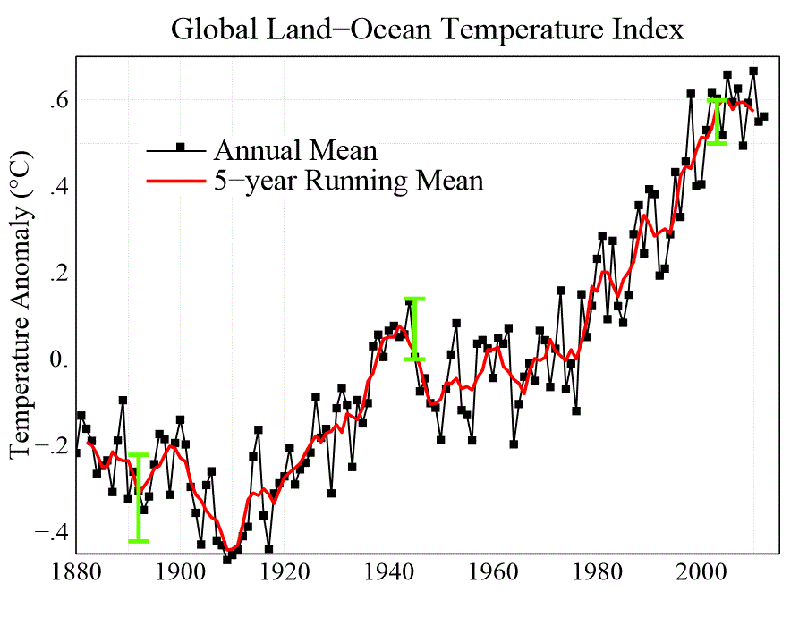
Prove It.
If you want to see evidence of a rise in mean global temperatures, take a look at this -

Slide 10
What is causing this change?
The Greenhouse Effect is largely responsible for making Earth hospitable to life and having water found in 3 states of matter.
This is due to the many greenhouse gases – primarily water vapor, but also CO₂, CH₄, and O₃.
CO₂ has risen from a level of 0.036% in the late 1970s to 0.040% as recently as 2013.
As small as this increase is, the negative effects have been predicted and observed.

Slide 11
What is being done?
Kyoto Protocol was signed in 1997 and signatories pledged to reduce greenhouse gas emissions to 5.2% below 1990 levels by 2012.
Special mechanisms were put in place to allow countries to barter and swap “credits” to achieve the goal.
To date, 191 countries have signed the protocol. Only one signatory country has yet to ratify the agreement.
That would be the United States.

Slide 12
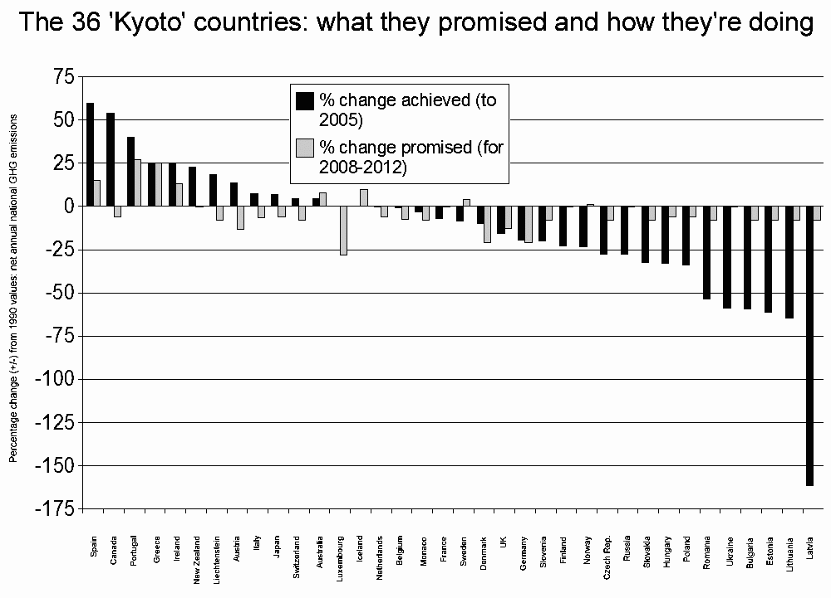
How are we doing?

Slide 13
Recent Developments
While initially supportive of the Kyoto Protocol, the United States withdrew from the agreement in 2001 as directed by President George W. Bush.
Instead, President Bush proposed a voluntary reduction of greenhouse gases by the US. Unfortunately, this proposal has resulted in a manipulation of the goals and, since they were voluntary, emissions have risen.
No change in US policy occurred during the Obama Presidency.
At this point, the US contributes 25% of the world’s greenhouse gas emissions and this amount continues to climb. Consider the US accounts for less than 5% of the world’s population.

Slide 14
Paris Agreement
Held in 2015.
Follows Kyoto Protocol
195 member nations have signed
Each nation is responsible for setting and monitoring their efforts to reduce greenhouse gas emissions.
In 2017, US President Donald Trump announced the US would withdraw from the agreement.
This is scheduled to occur in November 2020.

