Slide 1
Ocean Acidification
2/19/19

Slide 2
Catalyst – 2/19/19
Determine the conjugate bases of the following acids:
HCl
HNO₃
H₂SO₃

Slide 3
How to find conjugate bases?
Start with an acid
Remove one H
Add a negative charge
HF →
H₂SO₄ →

Slide 4
Refresher!
Find the conjugate bases of these acids:
HBr
H₃PO₄
H₂CO₃

Slide 5
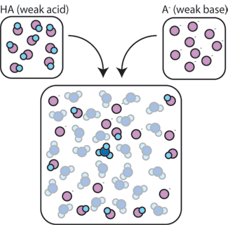
Buffers
A solution made of a weak acid and its conjugate base
ex:
HF and F⁻ together would make a buffer
H₂SO₄ and HSO₄⁻ together would make a buffer

Slide 7
Ocean Acidification and Climate Change
Notes:
Quick Poll – what do these words mean to you?

Slide 8
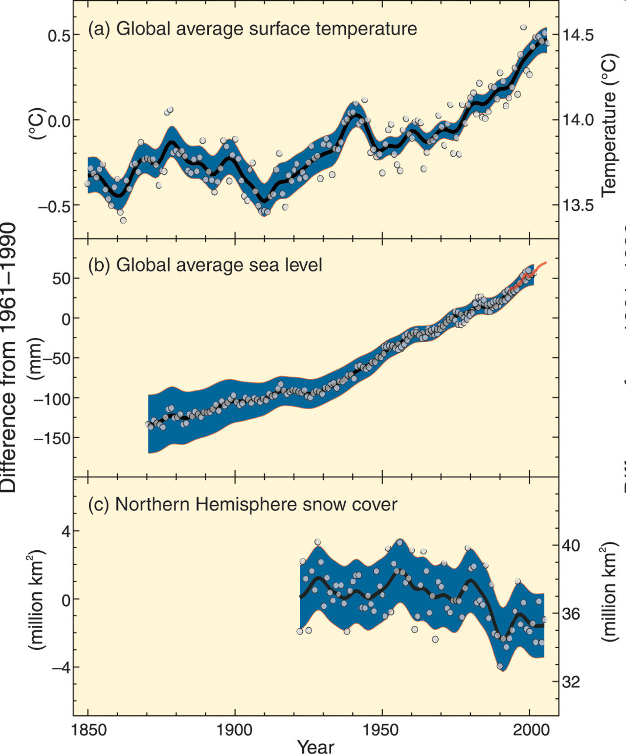
Source: IPCC AR4
Notes:
Most scientists agree that data such as the rise in ocean temperature and sea level and the decrease in Northern Hemisphere snow cover are clear indication of unequivocal human impact driving global warming.

Slide 9
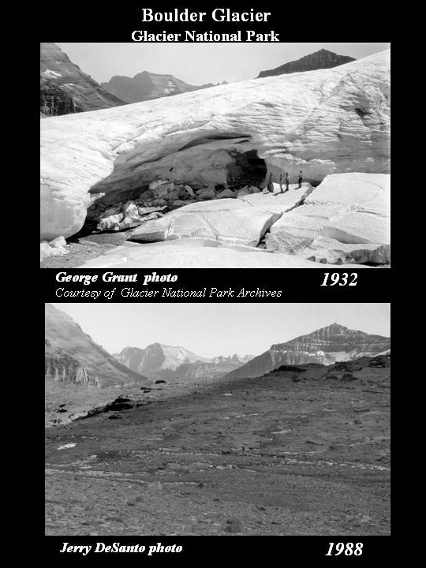
Why is this happening?
Notes:
This photographic evidence is just one example used to illustrate changes in climate. This is a very important example. Many communities near glaciers depend on these giant ice formations for fresh water. As the glaciers melt permanently, this source of water is stopped.

Slide 10
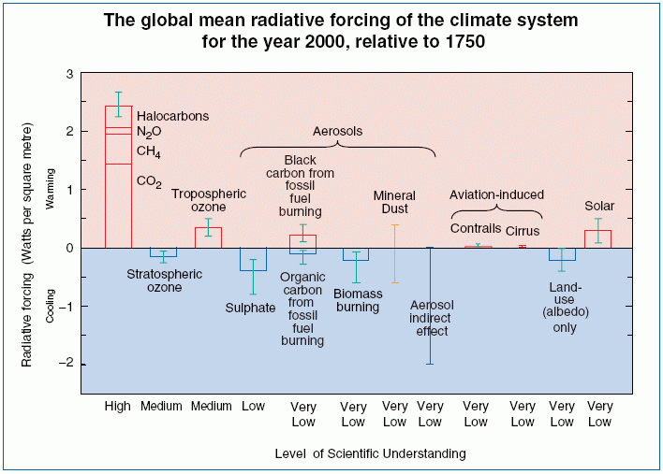
Source: IPCC TAR
Notes:
The image above, from the IPCC’s Third Assessment Report, plots the change in radiative forcing for different atmospheric constituents as a function of our level of scientific understanding for each constituent. The image is plotting differences in forcing in 1750 (before the industrial revolution) to the year 2000. “Solar” indicates the changes in incoming solar radiation. The industrial revolution marks the beginning of anthropogenic altering of the atmosphere through the combustion of large quantities of fossil fuels.

Slide 11
Source: IPCC TAR
Notes:
Clearly, the largest and most understood anthropogenic impact is the introduction of the “greenhouse gases” into the atmosphere. To understand this impact, we must understand what is meant by a “greenhouse gas”.

Slide 12
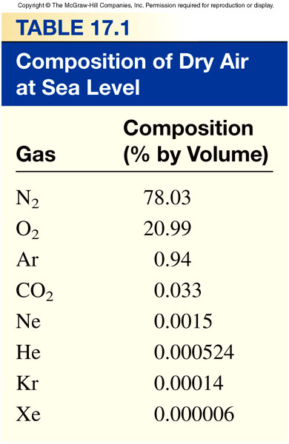
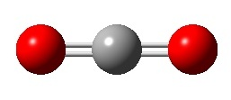
N₂
0.039309*
O₂
CO₂
* Source: ftp://ftp.cmdl.noaa.gov/ccg/co2/trends/co2_mm_mlo.txt
(average data for January2012, Mauna Loa, Hawaii)
Source: Chemistry by Chang
Notes:
Carbon dioxide is a heteronuclear triatomic molecule. The atoms in this gas are not all the same. The atoms in the carbon dioxide do not share their electrons evenly, resulting in polar covalent bonds that have a dipole moment. Quantum mechanics tells us and experiments prove that bonds with no dipole moment do not absorb infrared radiation while bonds with a dipole moment do.

Slide 13
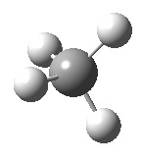
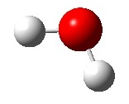
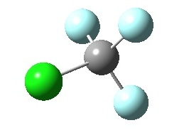
CO₂
N₂
CH₄
Not Greenhouse Gases
H₂O
O₂
Greenhouse Gases
CF₃Cl
Notes:
N₂ and O₂ will not absorb infrared light. CO₂, H₂O, methane (CH₄), and halocarbons like Freon (CF₃Cl) all have polar bonds and can absorb infrared light.
What do all these molecules have in common?

Slide 14
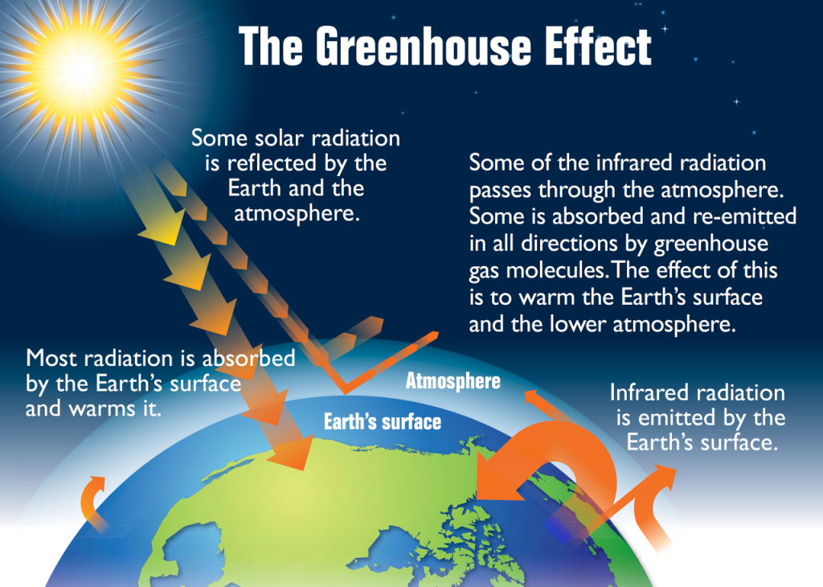

Slide 15
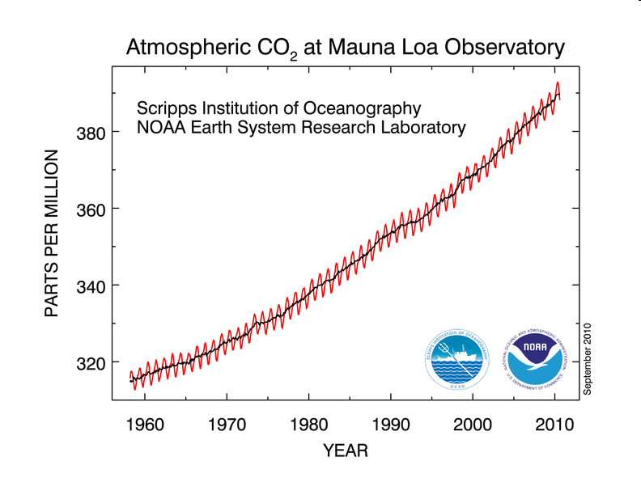
Yearly CO₂ Concentration Variation
Mauna Loa, Hawaii
http://www.esrl.noaa.gov/gmd/ccgg/trends/#mlo_full
Notes:
We can see the evidence of increased CO₂ levels from the burning of fuels in the Mauna Loa record. Note: Go to http://www.esrl.noaa.gov/gmd/ccgg/trends/#mlo_full to get the latest updated image including last month’s average.

Slide 16
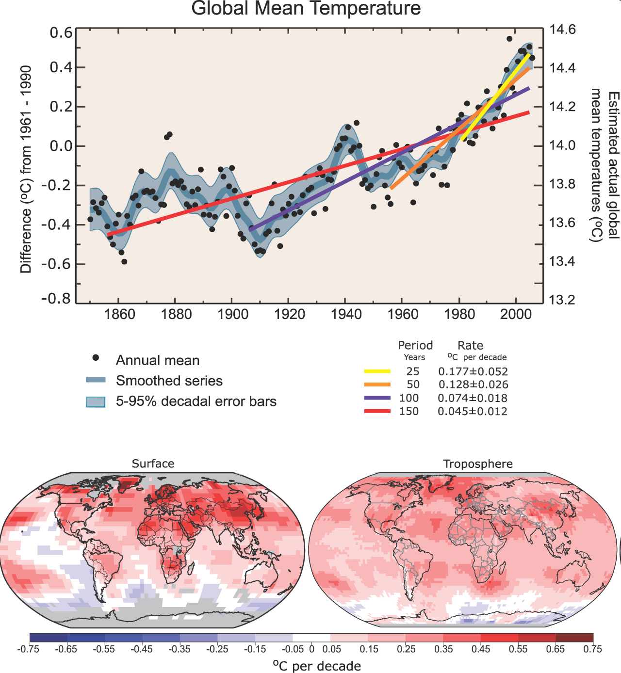
Source: IPCC AR4
Notes:
We can see that as the CO₂ concentration has increased, the global mean temperature has also increased. We would predict this knowing what we know understand about how CO₂ traps energy that would otherwise leave our system and, thereby, increases the temperature of our system.

Slide 17
What are the main sources of CO₂ being put into our atmosphere?

Slide 18
The ocean is a carbon sink
The ocean absorbs CO₂ from the atmosphere
Physical and biological processes move some of the carbon to the deep ocean where it is stored
The capture and
storage of carbon
is known as
carbon sequestration
Photo: NOAA
Our ocean
captures and stores carbon
Notes:
Photo:
NOAA, http://oceanservice.noaa.gov/education/pd/oceans_weather_climate/ocean_basics.html; Accessed: November 2010

Slide 19
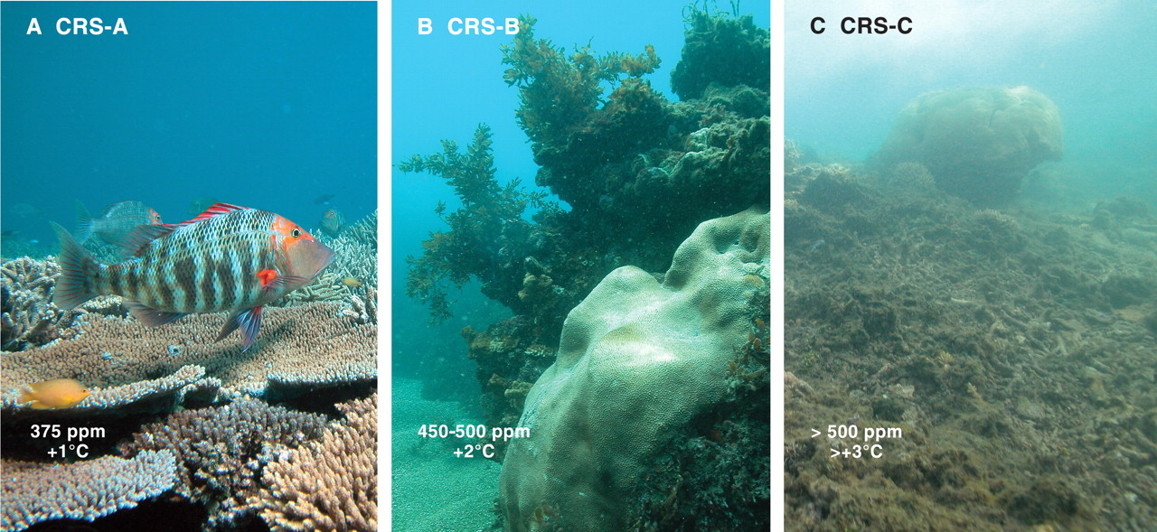
Ocean acidification: Impacts on ecological communities
Tropical Oceans Predictions:
Corals will become increasingly rare
Algae will become more abundant
Because coral reefs support so many animals, biodiversity will decline
Hoegh-Guldberg et al. 2007

Slide 20
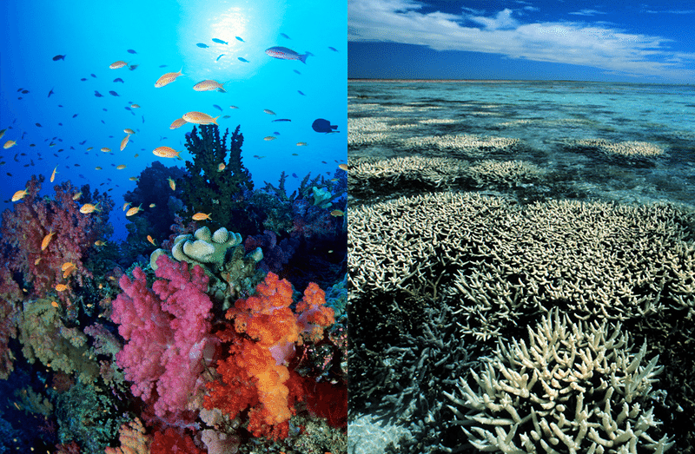

Slide 21
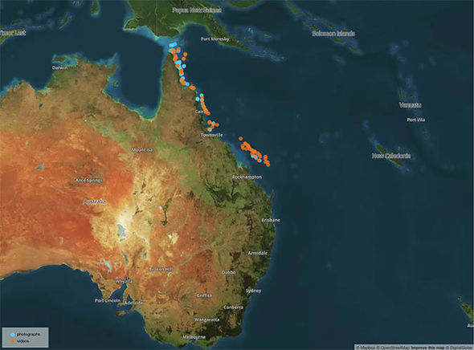
The Great Barrier Reef - Australia
Comprised of over 3000 individual reef systems
1500 fish species
5000 mollusk species
400 coral species
30 species of whales
Sea turtles, sea snakes, nesting birds, etc.

Slide 22
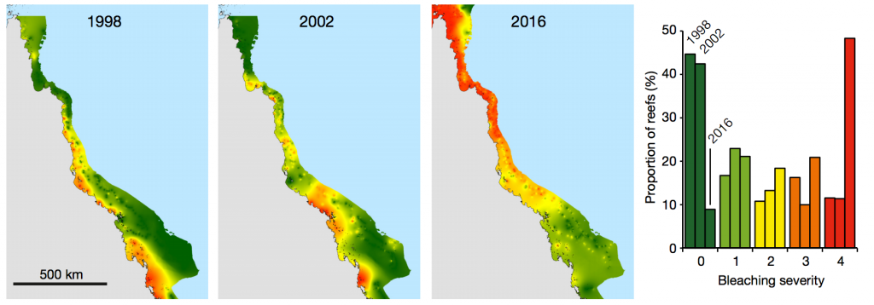
The Great Barrier Reef

Slide 23
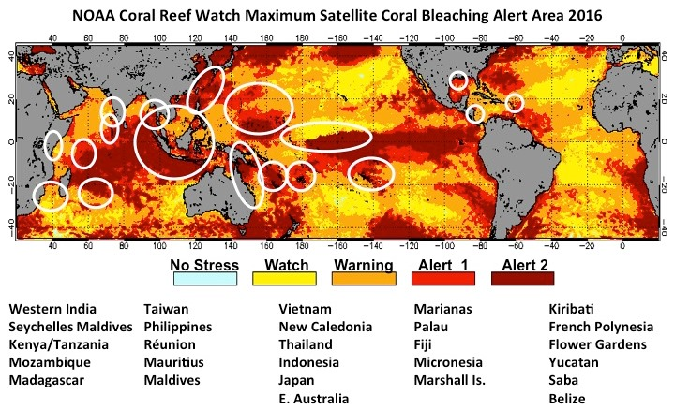

Slide 24
This Week…
We will explore the effects of CO₂ on oceans and solutions
We will research the underlying causes of oceans becoming more acidic and the impacts of this acidification on life on Earth
We will construct Public Safety Announcement posters (in class) depicting the main points of our findings

Slide 25
Predict the Products!
Al + O₂ →
Mg + O₂ →
C₆H₁₀O₅ + O₂ →
Zn + HCl →
Fe + CuSO₄ →
BaCl + NaSO₄ →
KI + Pb(NO₃)₂ →
NaOH + HCl →

Slide 26
Exit Ticket – Do on Catalyst Sheet
Determine the conjugate bases of these acids:
H₂CO₃
HClO₃

Slide 27
Catalyst – 2/21/19
Find the conjugate bases of these acids:
Hydroiodic acid: HI
Acetic acid: HC₂H₃O₂
Oxalic acid: H₂C₂O₄

Slide 28
Tuesday’s Guiding Questions
What is a greenhouse gas?
How have the levels of CO₂ been changing over the years?
What is causing CO₂ levels to change?

Slide 29
Today’s Guiding Questions
How might increasing CO₂ levels affect oysters in the Chesapeake Bay?
What does CO₂ do when dissolved into salt water?
How are oysters important to marine ecosystems and to humans?

Slide 30
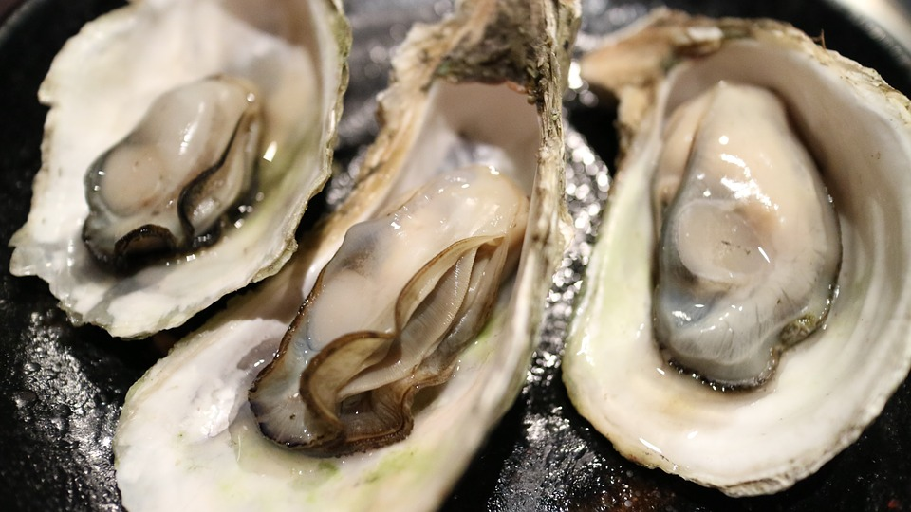
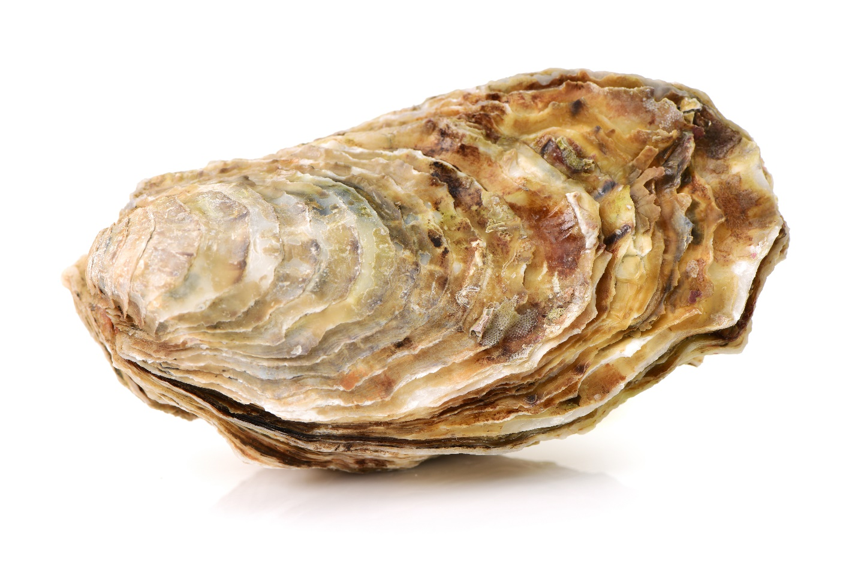
Reading - All About Oysters

Slide 31
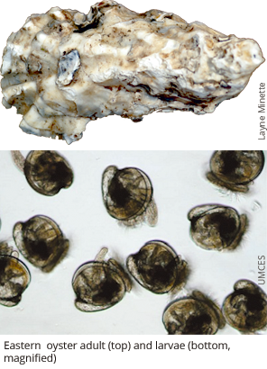
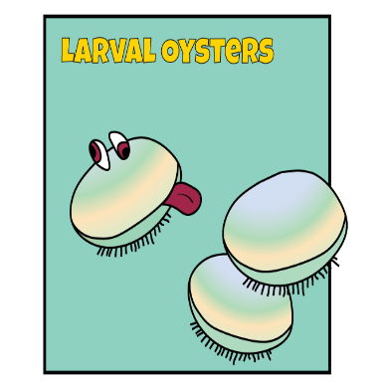
Photo credit Steve Vilnet
http://www.squidtoons.com/uploads/2/2/5/9/22596580/7373245_orig.png
Notes:
Key points from “All about Oysters” reading

Slide 32
Now that you know a little bit about oysters…
*While watching, listen for the effects of CO₂ and carbonate (CO₃²⁻) on oyster shells!
https://www.youtube.com/watch?v=Wo-bHt1bOsw
Notes:
Ocean Acidification Video: STOP the video at 1 min 13 secs. If you do not, the video gives away the answers the students are working to figure out on their own throughout this activity.
By now you’ve heard that the way we’re living is filling up our atmosphere with CO2. As a result, the planet’s warming. Heat waves and floods are more likely to be extreme and people’s lives will get tougher. And the more we learn about climate change, the more risks we uncover. Since we started burning fossil fuels, the ocean has absorbed about half of all the co2 we humans have put out. That’s why it’s called the planet’s biggest carbon sink. Now this is good, because it’s kept a lot of CO2 out of the atmosphere. But as the ocean warms, it takes up less and less CO2. And with all that CO2 in the sea, scientists are shedding light on, well, an ocean of problems.
Ready for the first big problem? Some sea creatures like clams, oyster and coral, their shells and skeletons are getting weaker. Okay, you got bigger problems than easy to crack clams? Maybe not, if you’re among the 1 in seven people who get most of their protein from seafood. Or if you understand how unstable the world would be with a billion more hungry people.
This will link oysters to the concept of climate change. By stopping at 1:13, we don’t yet say what CO2 does to ocean.

Slide 33
What is the conjugate base of H₂CO₃?
H₂CO₃ → H⁺ + HCO₃⁻
Acid
Conjugate base
This makes a buffer!

Slide 34
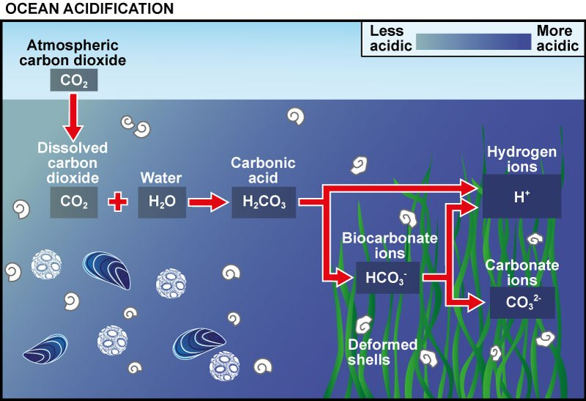

Slide 35
Video – Calcium Carbonate in Oceans
NC Aquarium
https://www.youtube.com/watch?v=kxPwbhFeZSw
* While watching, listen for the effect of BICARBONATE on oyster shells

Slide 36
How do oyster larvae form shells?
Ca⁺²
CO₃⁻²
CO₃⁻²
CO₃⁻²
Ca⁺²
Ca⁺²
Carbonate
Calcium
Ca⁺²
CO₃⁻²
Ca⁺²
CO₃⁻²
CO₃⁻²
CO₃⁻²
Ca⁺²
CO₃⁻²
Ca⁺²
Calcium carbonate

Slide 37
How do oyster larvae form shells?
Ca⁺²
CO₃⁻²
CO₃⁻²
CO₃⁻²
Ca⁺²
Ca⁺²
Carbonate
Calcium
Ca⁺²
If oyster larvae can’t form shells, they cannot eat and they don’t survive to reproduce.
CO₃⁻²
CO₃⁻²
CO₃⁻²
Ca⁺²
Ca⁺²
CO₃⁻²
CO₃⁻²
Ca⁺²
Calcium carbonate

Slide 38
Why does it matter that oyster populations are declining?

Slide 39
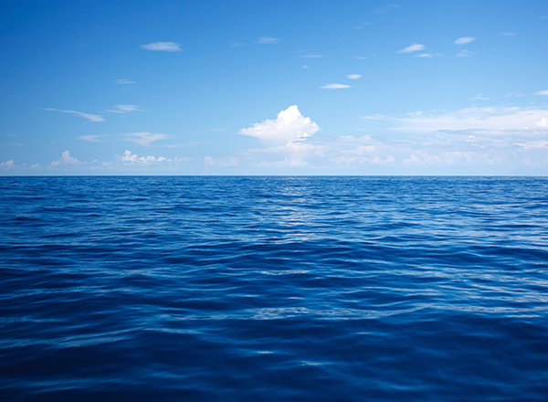
How does a more acidic ocean affect oyster larvae’s ability to build shell?

Slide 40
Today’s Guiding Questions
How might increasing CO₂ levels affect oysters in the Chesapeake Bay?
What does CO₂ do when dissolved into salt water?
How are oysters important to marine ecosystems and to humans?

Slide 41
Ocean Acidification Project
2/25/19 and 2/26/19

Slide 42
2/25/19 – Ocean Acidification Report
3 Paragraphs
Intro and what is ocean acidification
CO₂ reactions and effects on the ocean
Effects on marine life, focusing on Chesapeake Bay oysters
PLUS a visual aid
Depicting the flow of CO₂ from its sources into the ocean and what CO₂ does when dissolved in the ocean
Spelling and grammar count!
In the computer lab today and tomorrow
Due Wednesday before class

Slide 43
Guiding Questions for the Project…
What is a greenhouse gas?
How have the levels of CO₂ been changing over the years?
What is causing CO₂ levels to change?
How might increasing CO₂ levels affect oysters in the Chesapeake Bay?
What does CO₂ do when dissolved into salt water?
How are oysters important to marine ecosystems and to humans?
How does CO₂ affect the pH of water? (LAB)

