Slide 1
Non-Renewable Energy
How much of this stuff we got?

Slide 2
Hydrocarbons Revisited
Remains of organisms that lived millions of years ago.
Partially decomposed under enormous pressure and temperature.
3 main types –
Coal – arguably 220 year supply*
Petroleum (oil) – arguably 65 year supply*
Natural gas – arguably 300 year supply*
* At current usage rates
2% increase per year equals coal – 65 years, oil – 42 years, and natural gas – 80 years.

Slide 3
Depletion
Economic Depletion – when 80% of a resource has been extracted and remaining 20% is too expensive to affordably extract.
Absolute Depletion – resource is effectively exhausted.

Slide 4
Coal
3 types of coal
Lignite (softest, lowest potential heat content)
Bituminous
Anthracite (hardest, highest potential heat content)
All coal contains varying amounts of sulfur and nitrogen.
When coal is burned, these elements (along with carbon) form oxides that combine with moisture in the atmosphere to produce acid precipitation.
CO_{x} becomes Carbonic Acid
NO_{x} becomes Nitric Acid
SO_{x} becomes Sulfuric Acid

Slide 5
Acid Deposition
Precipitation which falls through the atmosphere collects many chemicals and particulate matter as it descends.
This precipitation can be collected and its pH determined.
Rainwater can have a natural pH as low as 5.7, due to the reaction of CO₂ and water.
Acid precipitation slowly and chemically wears away stone and metal structures.
Damage done by acid deposition is estimated at more than $287 billion/year (EPA – 2013).
Additionally, as CO₂ levels in the atmosphere rise, more will diffuse into the world’s oceans, resulting in acidification.

Slide 6
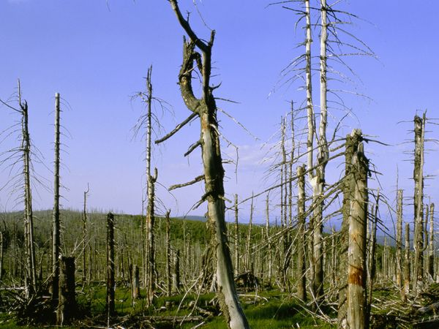
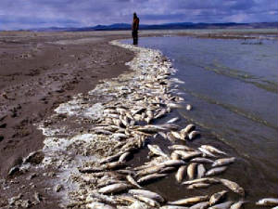
Damage

Slide 7
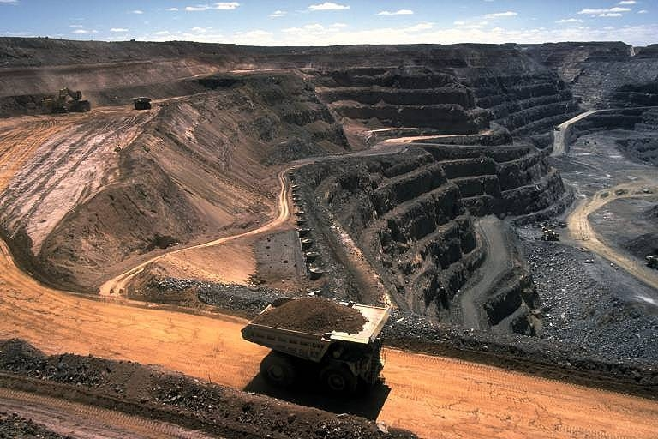
Coal Reserves
Most US coal production is domestic.
Mining is typically done by strip mining.

Slide 8
Strip Mining Machinery

Slide 9
Damage from Coal Mining
Tailings (non-useful removed material) need to be pile stored.
Chemicals used to isolate coal from contaminants runs off into streams and rivers.
Topography is destroyed.
Transportation of material is expensive and contributes to pollution.
Fires are not uncommon.
COPD, Black Lung Disease, Emphysema

Slide 10
Petroleum (oil)
Primary recovery is the least expensive process of recovery. This involves drilling and pumping oil from the ground.
Secondary recovery involves injecting water into the ground to force heavy oil to flow to wellhead.
Tertiary recovery involves injecting steam or CO₂ into the ground to force heavy oil to flow to wellhead.
New resources are identified continually, but in more remote and inaccessible locations.
Oil is refined through fractional distillation into various substances.
Transportation is key to costs.
If prices are to remain low, infrastructure (pipelines, refineries, gas stations) must be widely distributed.

Slide 11
Fractional Distillation

Slide 12
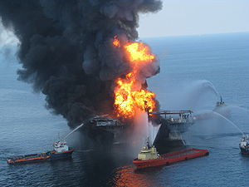
Oil Drilling Accidents and Spills
Deepwater Drilling is main source of crude.
Water depths in excess of 5,000 feet are common.
Wells are held in position by GPS and computer-controlled thrusters.
Deepwater Horizon (BP) exploded and sank on April 20, 2010.

Slide 13
Deepwater Horizon Explosion
At 9:45 P.M. CDT on 20 April 2010, during the final phases of drilling the exploratory well at Macondo, a geyser of seawater erupted from the marine riser onto the rig, shooting 240 ft (73 m) into the air. This was soon followed by the eruption of a slushy combination of mud, methane gas, and water. The gas component of the slushy material quickly transitioned into a fully gaseous state and then ignited into a series of explosions and then a firestorm. An attempt was made to activate the blowout preventer, but it failed.^{[45]}
At the time of the explosion, there were 126 crew on board; seven were employees of BP, 79 of Transocean, there were also employees of various other companies involved in the operation of the rig, including Anadarko, Halliburton and M-I SWACO.^{[46]} Eleven workers were presumed killed in the initial explosion. The rig was evacuated, with numerous injured workers airlifted to medical facilities. After burning for approximately 36 hours, Deepwater Horizon sank on 22 April 2010. The remains of the rig were located resting on the seafloor approximately 5,000 ft (1,500 m) deep at that location, and about 1,300 ft (400 m) (quarter of a mile) northwest of the well.^{[39][47][48]}
The resultant oil spill continued until July 15 when it was temporarily closed by a cap.^{[49]} Relief wells were used to permanently seal the well, which was declared "effectively dead" on September 19, 2010.^{[50]}
up to 4.9 million barrels (210,000,000 US gallons; 780,000 cubic meters)^{[3]} spilled.

Slide 14
Exxon Valdez
The Exxon Valdez oil spill occurred in Prince William Sound, Alaska, on March 24, 1989, when the Exxon Valdez, an oil tanker bound for Long Beach, California, struck Prince William Sound's Bligh Reef and spilled 260,000 to 750,000 barrels (41,000 to 119,000 m³) of crude oil.^{[1][2]} It is considered to be one of the most devastating human-caused environmental disasters.^{[3]} The Valdez spill was the largest ever in U.S. waters until the 2010 Deepwater Horizon oil spill, in terms of volume released.^{[4]} However, Prince William Sound's remote location, accessible only by helicopter, plane, and boat, made government and industry response efforts difficult and severely taxed existing plans for response. The region is a habitat for salmon, sea otters, seals and seabirds. The oil, originally extracted at the Prudhoe Bay oil field, eventually covered 1,300 miles (2,100 km) of coastline,^{[5]} and 11,000 square miles (28,000 km²) of ocean.^{[6]} Then Exxon CEO, Lawrence G. Rawl, shaped the company's response.^{[7]}

Slide 15
Exxon Valdez (continued)

Slide 16
Price of Gas over last 30 years

Slide 17
Unconventional Recovery
Tar sands – clay and sand deposits with large amount of thick petroleum. Tar sands are strip-mined and then filtered and refined to produce oil. This process is far more expensive than conventional oil recovery.
Shale oil – petroleum in sedimentary rock. Recovery of oil from this rock is expensive and environmentally damaging.
“Fracking” – injection of hydraulic fluids (primarily water) into the ground to fracture subterranean rock and force petroleum into well-heads.
Fracking is alleged to have caused contamination of groundwater and increased the level of soil toxicity.
Recently, several states have banned fracking.

Slide 18
Natural Gas
Natural Gas is typically found associated with subterranean oil fields. The gas collected in the top of a “dome”, after separating from the petroleum.
Gas was typically burned off on site, and only recently is being captured to use as a fuel source.
Natural Gas is a mixture of several hydrocarbons (typically the first 5) and is essentially odorless upon extraction. An odorant (sulfur) is added to detect leaks.
For the most part, Natural Gas is the least polluting of the fossil fuels.

Slide 19
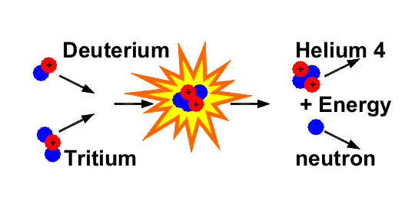
Energy from the Atom
Energy can released from atomic nuclei by way of fusion (joining two small nuclei into one larger nucleus) or fission (splitting one nucleus into smaller nuclei).
Stars are examples of large fusion reactors. Hydrogen nuclei are fused to form helium nuclei and energy is released.

Slide 20
Uranium enrichment
Uranium ore contains 97% uranium-238, which is non-fissionable.
Uranium ore is mined and refined to increase the purity of Uranium-235 (which is fissionable) from 0.7% to 3%. This process is incredibly difficult and expensive.
For weapons grade fuel, the purity must be increased several-fold. This increases the difficulty and expense exponentially.

Slide 21
Atomic History
Radioactivity is discovered in 1896 when Antoine Henri Becquerel, professor at Ecole Polytechnique in Paris, when he was trying to link x-rays with phosphorescence. He placed a chunk of uranium on a photographic plate, which was wrapped in black paper in bright sunlight. When later examined, the plate had an image left by the crystal. Becquerel incorrectly assumed this was due to the sunlight causing the uranium crystal to phosphoresce. Later, on a cloudy day, he placed another wrapped plate and the uranium in a desk drawer. The plate, once again, contained an image of the uranium crystal. He correctly deduced that energy was being emitted from the uranium and the cause of the image was not due to phosphorescence. Madame Curie confirmed and extended this two years later.

Slide 22
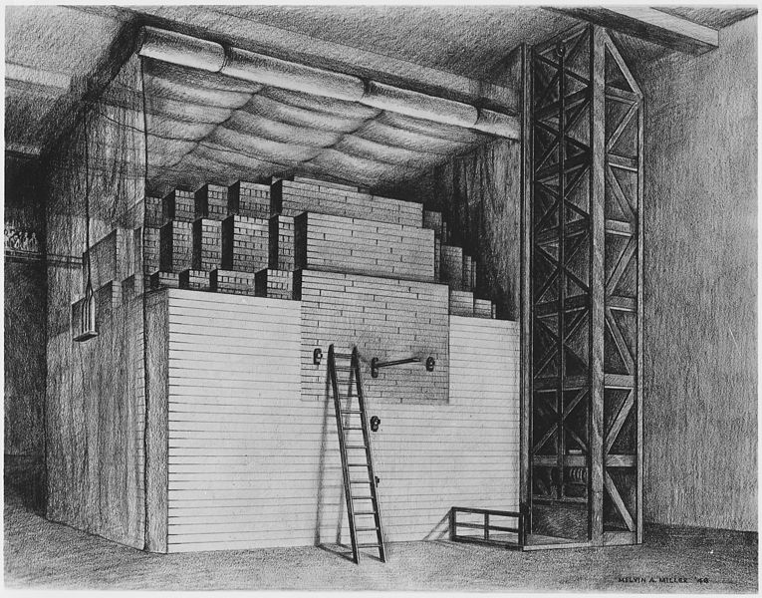
More Atomic History
December2, 1942 – Enrico Fermi constructs a “nuclear pile” in a squash court beneath the unused football stadium Stagg Field at the University of Chicago.

Slide 23
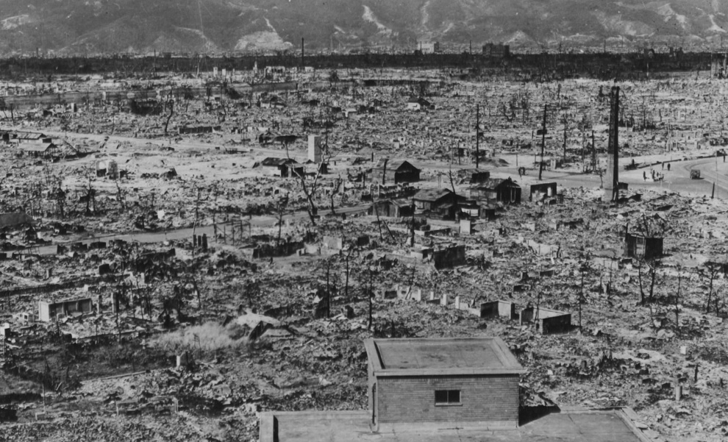
Still More Atomic History
The Manhattan Project, J. Robert Oppenheimer
July 16, 1945 – Alamagordo, NM was the sight of the first test of an atomic explosive device. Plutonium device.
August 6, 1945 – Hiroshima, Japan. Uranium device.
August 9, 1945 – Nagasaki, Japan. Plutonium device.

Slide 24
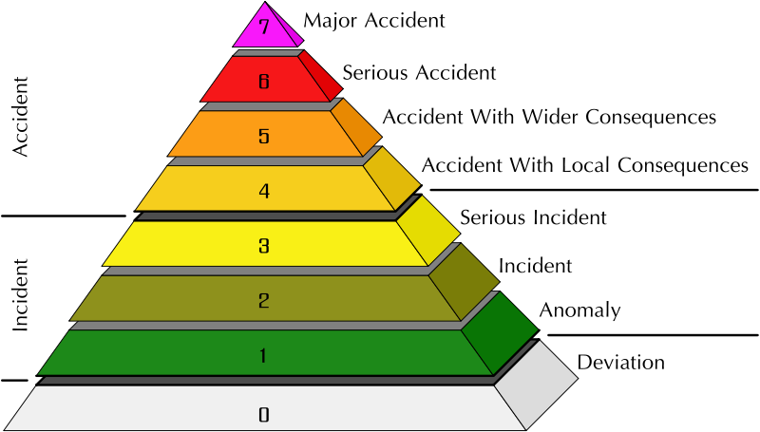
Nuclear Accidents
March 28, 1979 – Three Mile Island, near Harrisburg, PA. Partial core meltdown. Level 4 Accident.
April 26, 1986 – Chernobyl, Ukraine. Core overheated, coolant water vaporized and reactor exploded. Sweden raised the alarm because of a spike in atmospheric radiation. Level 7 Accident.
March 11, 2011 – Fukushima, Japan. Earthquake and resulting tsunami cause damage and loss of power to nuclear power plant. Level 7 Accident.

Slide 25
Fission reactor
Fuel rods containing fissionable fuel are submerged in water and surrounded by Cadmium control rods absorb excess neutrons to regulate the rate of reaction.
As energy demands increase, control rods are withdrawn from the core and the rate of fission increases. This superheats the water, which transfers its heat energy to a secondary and tertiary water supply. Stem is used to drive a turbine, which is connected to a generator, to produce electrical energy.

Slide 26
Light-water moderated reactor

Slide 27
Nuclear Waste
Radioactive isotopes possess a half-life. This represents the number of years for 50% of the fuel to decay into a more stable form.
Uranium-238 4.5 billion years
Uranium-235 710 million years
Plutonium-239 24,000 years
Iodine-131 8 days
Waste needs to be stored for a period of 10 half-lives to be considered “safe”.

Slide 28
Military Nuclear Waste Storage
Military grade nuclear waste (from propulsion reactors and weapons) are being stored in glass lined steel drums in Carlsbad Caverns, NM.
Carlsbad Caverns was formed millions of years ago when acidic runoff scoured away porous, sandy rock to create a vast cavern network.
The soil is geologically stable, but the acidic runoff continues to flow into the caverns. At this time, the military adds buffers and pumps out the water to protect the integrity of the storage containers.

Slide 29
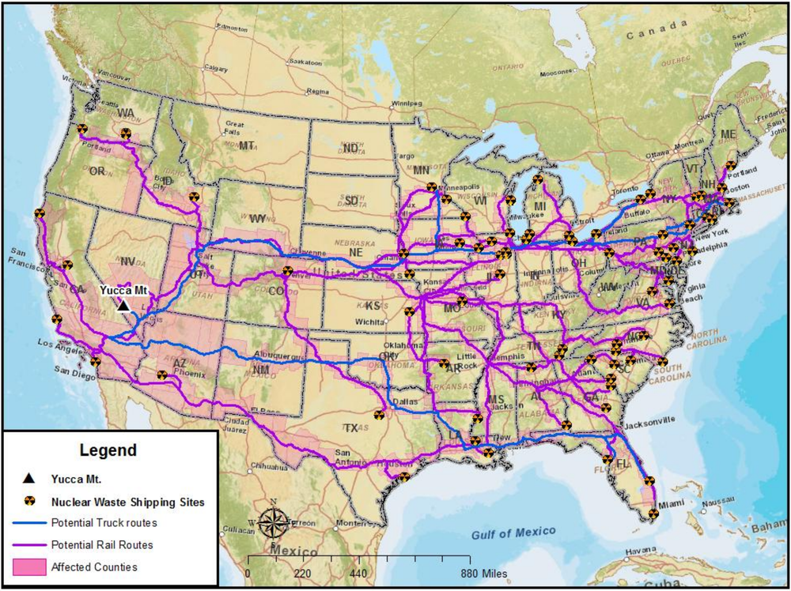
Civilian Nuclear Waste Storage
Waste is currently stored in large pools on site.
Waste is slated to be stored in Yucca Mountain, NV.

Slide 30
Breeder Fission Reactor
Non-fissionable Uranium-238 is converted into fissionable Plutonium-239, which is then used to drive the reactor.
In theory, the process creates more fuel than it uses, so fuel supplies will last many thousands of years.
This process is currently non economically feasible at current prices.
France has developed a breeder reactor, but the construction cost was 3x the estimate and the electricity produced costs 2x that of a conventional fission reactor.

Slide 31
Fusion
Where is the nearest fusion reactor?
The Sun
Isotopes of Hydrogen (Deuterium and Tritium) are heated to incredibly high temperatures and contained in a small area.
Some of the nuclei fuse, releasing a neutron and large amounts energy.
The waste product is helium, which is non-reactive and has no radioactivity.
If we can achieve this on Earth, everything changes.

