Slide 1
Do Now
Directions:
Take out your HW
Fill out the reflection log for week 4
Notes:
35, 35, 45

Slide 2
Pathway to Success
Follow directions the first time they are given
Remain a curse free zone
No distractions
No food or drinks
No electronics unless approved

Slide 3
Objective
SWBAT …
Demonstrate their understanding of general chemistry, properties of water, and acids and bases

Slide 4
Agenda
QUIZ
Hand back blog
Chesapeake Bay Report

Slide 5
Quiz expectations
NO ELECTRONIC DEVICES
REMAIN SILENT UNTIL EVERYONE IS DONE
EYES ON YOUR OWN PAPER
Do NOT write on the quiz
Answer on a separate sheet of paper!
Number your paper 1-25
Answers
Q#12 = A
Q#22 = B

Slide 6
Characteristics of Living Lab
Class average 80%
4 people didn’t turn it in = 0

Slide 7
Hand back blog
Average grade on blog
Period 1: 81%
Period 2: 66%
Period 4: 70%

Slide 8
Importance of water for our body

Slide 9
Importance of water for human society
Household purposes
Agriculture
Industry
Transportation
Recreation

Slide 10
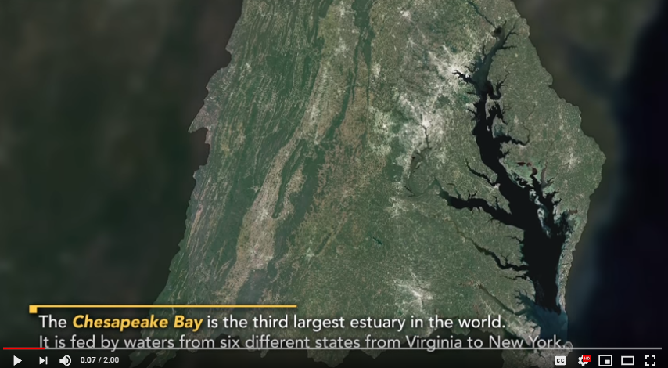
Chesapeake Bay Report
https://www.youtube.com/watch?v=RzPkK1JQ7c8

Slide 11
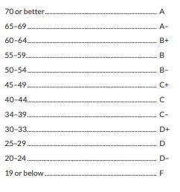
Bay Report

Slide 14
Notes:
21 ft deep

