Slide 1
Aquatic Biomes
aka: Wet Homes

Slide 2
Water
Water is classified as:
Freshwater (<0.05% salinity)
Brackish (0.05 – 3% salinity)
Saline (3 – 5% salinity)
Brine (>5% salinity)

Slide 3
Distribution of Water

Slide 4
Freshwater
Freshwater can be found as flowing (in rivers and streams) or standing (in lakes and ponds).
Flowing freshwater characteristics vary greatly over the course of a tributary.
Near the source (headwaters), the water tends to be swift, cold, and high in dissolved oxygen.
As the water flows downward, smaller streams join to form larger streams and rivers.
Water in larger rivers flows more slowly.
What happens to the temperature of the water in a river as the flow rate drops?
As a result, what happens to the DO?
Take note of how each characteristic of Flowing Freshwater changes as the water flows from the source to the mouth.

Slide 5
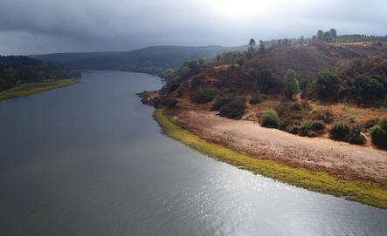
Comparison

Slide 6
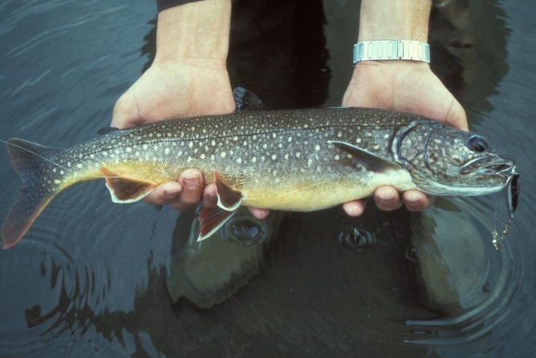
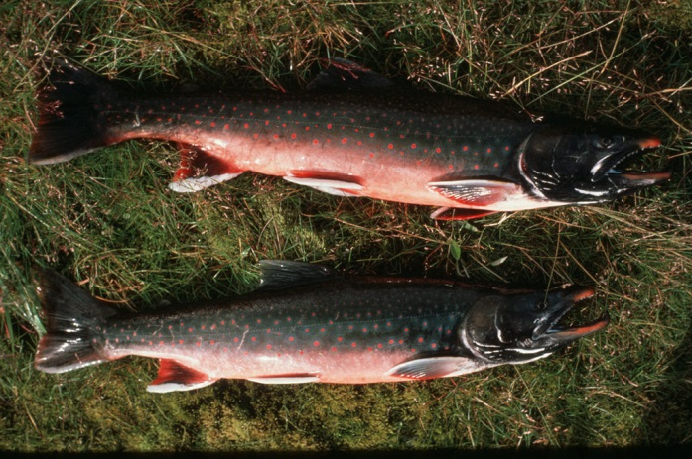
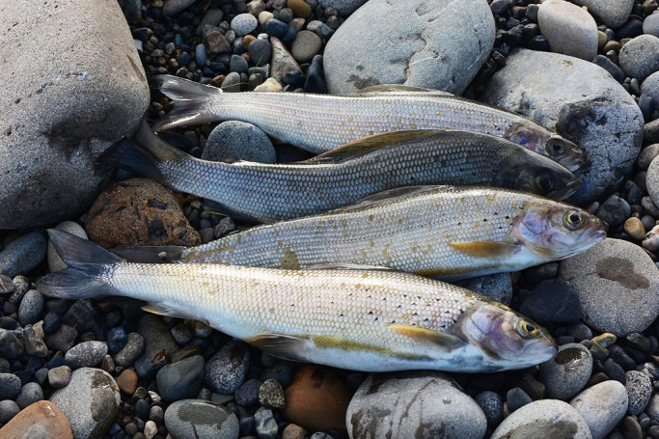
Wildlife in rivers and streams
Fish near headwaters tolerate cold temps and have high DO demand.
They tend to have streamlined bodies and are strong swimmers.
Examples include trout, char, and grayling.

Slide 7
Stream Trophic levels
Producers – algae and phytoplankton
Primary consumers – zooplankton and small fish
Secondary consumers – large predators
Tertiary consumers – rarely found in freshwater streams and rivers.

Slide 8
Threats to freshwater streams and rivers
Development introduces sediment, which will cloud the water (increase turbidity), thus reducing photosynthesis.
Development creates additional amounts of runoff, which causes extreme fluctuations in flow volume.
Deforestation removes tree canopy, which allows sun to warm water.
As a result of these changes, fish species face three choices – move, adapt, or die.

Slide 9
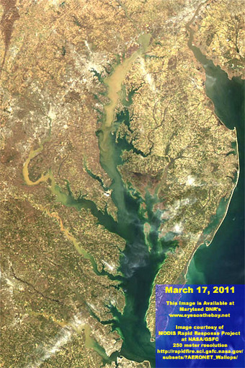
Sedimentation due to development in Chesapeake Bay

Slide 10
Societal forces creating “exurbanization”
Historically, people settled in towns and cities, as that is where they could find employment and housing.
In the last several decades, there has been a large-scale flight of residents from cities to suburbs.
What types of advances, technologies allowed this to occur?
What attitudes fostered a sense of needing to leave a city?
Baltimore census – 1950: 950,000, 2010: 621,001
Recently, Baltimore City has seen the drop in population halt, while the number of taxpaying households has increased.
Explain that.

Slide 11
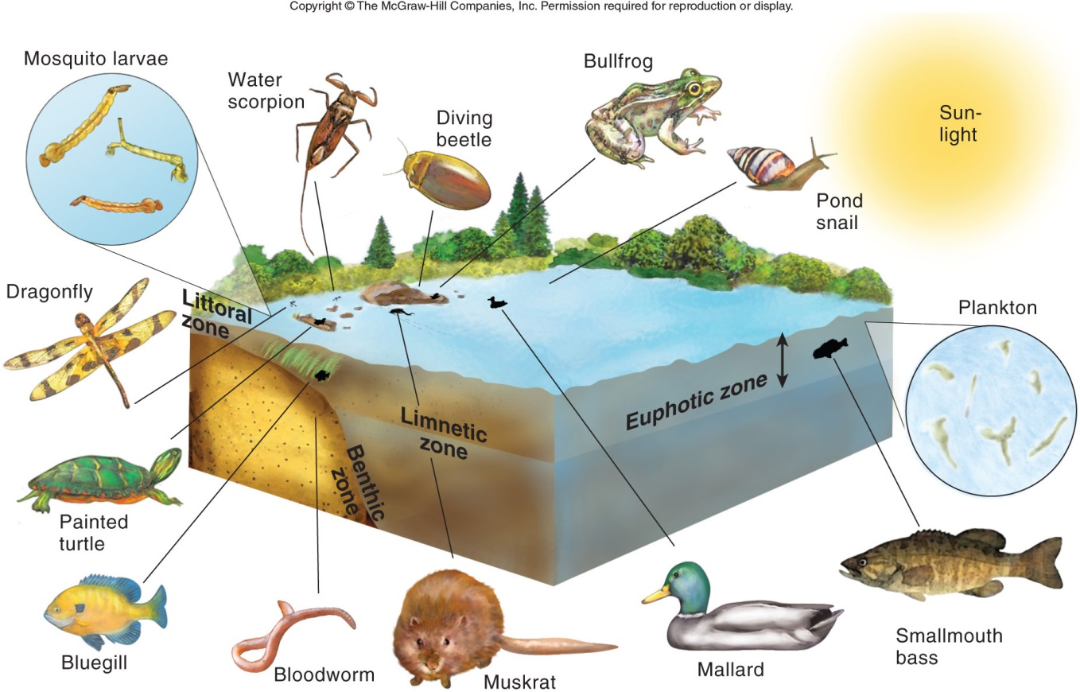
Standing Freshwater
There are 4 zones associated with standing freshwater.

Slide 12
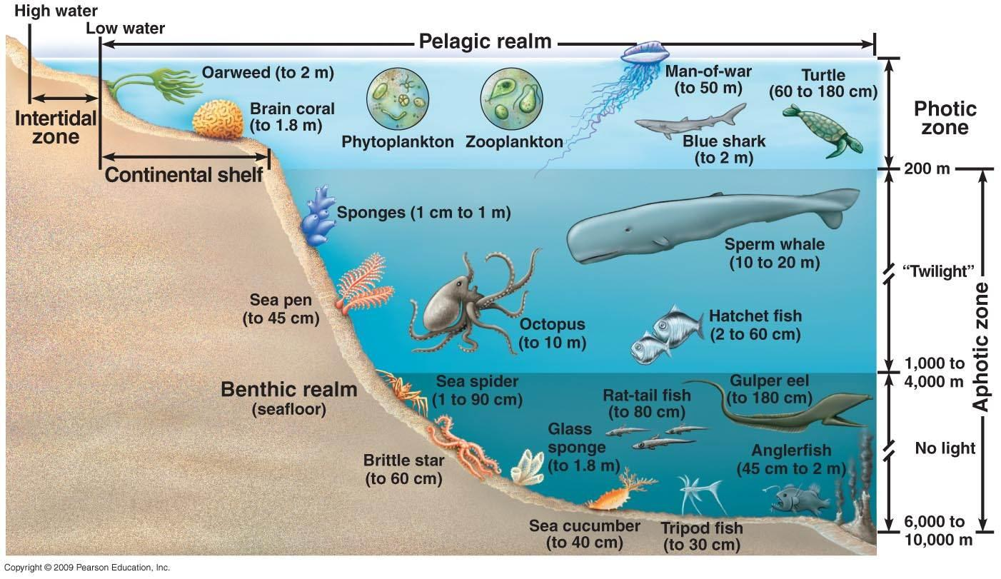
Marine zones
There is a similar arrangement in saltwater.

Slide 13
Similarities
Note how the 4 zones of Standing Freshwater are quite similar to the 4 zone of the Ocean.
Compare the 2 biomes and note which Standing Freshwater zone matches which Oceanic zone.

